Slide 1
The Stories They Tell: My Interactions with the Business and How Storytelling Creates Leaders
Ben Barnard
Notes:
Hello, I am Ben Barnard, a data scientist at Well Fargo. I live in Fort Worth, Texas. My interests include communicating to leaders and consulting across the business. This leads us to this presentation. ”The Stories They Tell: My Interactions with the Business and How Storytelling Creates Leaders.”

Slide 2
"It was the best of times, it was the worst of times, it was the age of wisdom, it was the age of foolishness, it was the epoch of belief, it was the epoch of incredulity, it was the season of Light, it was the season of Darkness, it was the spring of hope, it was the winter of despair, we had everything before us, we had nothing before us, we were all going direct to Heaven, we were all going direct the other way—in short, the period was so far like the present period, that some of its noisiest authorities insisted on its being received, for good or for evil, in the superlative degree of comparison only."
Notes:
"It was the best of times, it was the worst of times, it was the age of wisdom, it was the age of foolishness, it was the epoch of belief, it was the epoch of incredulity, it was the season of Light, it was the season of Darkness, it was the spring of hope, it was the winter of despair, we had everything before us, we had nothing before us, we were all going direct to Heaven, we were all going direct the other way—in short, the period was so far like the present period, that some of its noisiest authorities insisted on its being received, for good or for evil, in the superlative degree of comparison only.” Are we in contrasting times of extremes? What can make the difference between the best of times and the worst of times? First and foremost, how we communicate or the stories we tell define how our analytics are used, whether we create champions, or if we just become a story they tell. In this presentation I will

Slide 3
Who are you?
Citizen Data Scientist
Academic Professor
20-year veteran
CEO
Research Scientist

Slide 4
It was a pleasure to p-value.

Slide 5
Power Analysis
Determine:
Sample size
Type I error
Type II error
Effect size
Tie the business need with the statistical test
In a world we made up why don’t we set values to our benefit

Slide 6
All good predictive models are alike; each bad predictive model is bad in its own way.

Slide 7
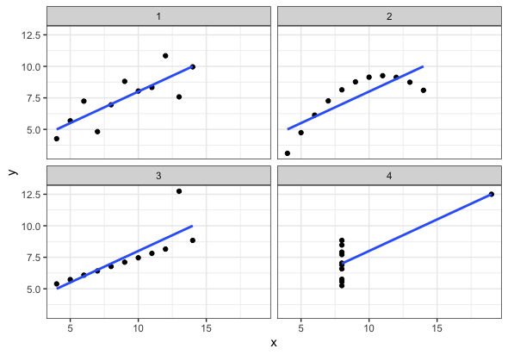
Anscombe’s Quartet
Mean of x and y
Sample variance of x and y
Correlation between x and y
Linear regression line
Coefficient of determination

Slide 8
It is a truth universally acknowledged, that a business in possession of data, must be in want of a data scientist.

Slide 9
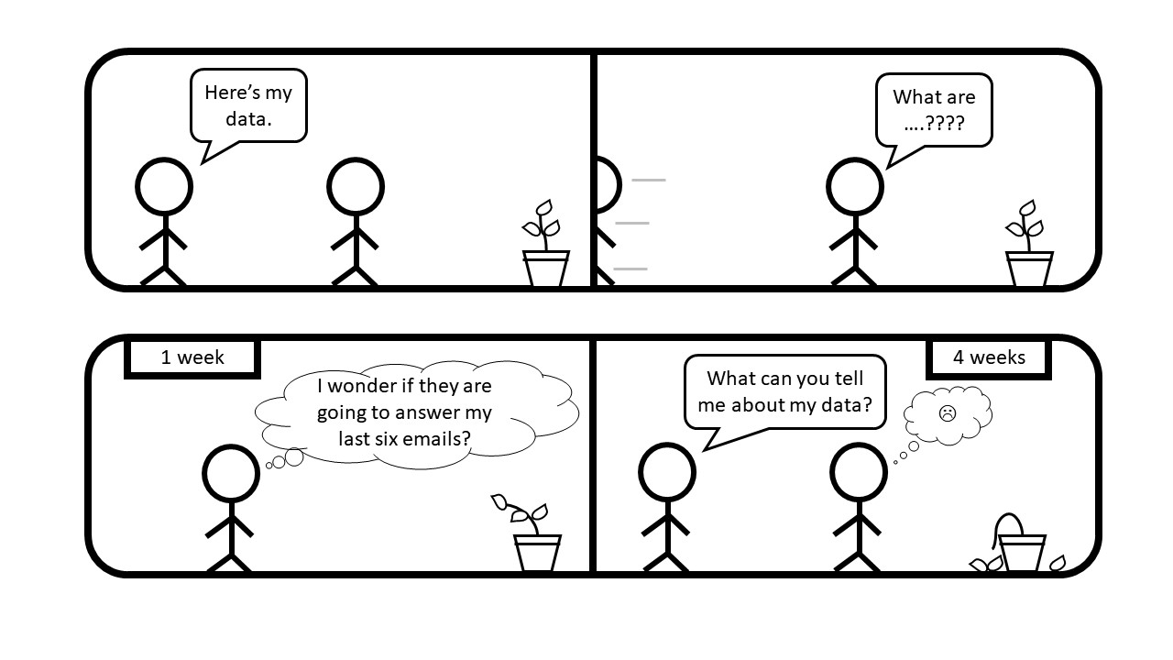
Collaborative Analytics
Analytics isn’t a waterfall, but agile and dynamic
If you are wearing a bulletproof vest something is wrong
You are the expert

